Slide 1




MART: Memory-Augmented Recurrent Transformer for Coherent Video Paragraph Captioning
Jie Lei¹, Liwei Wang², Yelong Shen³,
Dong Yu², Tamara L. Berg¹, Mohit Bansal¹
¹UNC Chapel Hill, ²Tencet AI Lab, ³Microsoft Dynamics 365 AI
Tencent
AI Lab
ACL 2020
Notes:
Hello everyone, I am Jie. Today I am going to present our paper, MART: Memory-Augmented Recurrent Transformer for Coherent Video Paragraph Captioning.
My collaborators are Liwei, Yelong, Dong, Tamara and Mohit.

Slide 2

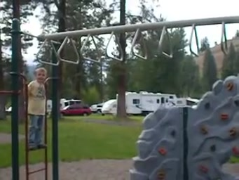
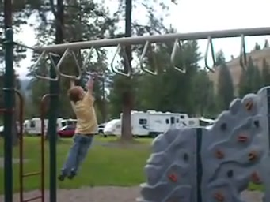
Video Captioning
A boy goes across the monkey bars.
ACL 2020
[Krishna et al., ICCV 2017]
Notes:
In video captioning, the task is to generate a natural language description capturing the content of a video.
For example, for this video clip, we might want to describe it as “A boy goes across the monkey bars.”
Single video captioning is useful when describing a very short video clip. In real world, we are often dealing with much longer videos, and we are interested in captioning a coherent and concise multi-sentence stories about them.

Slide 3
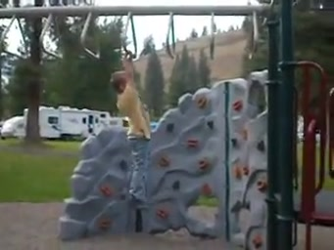
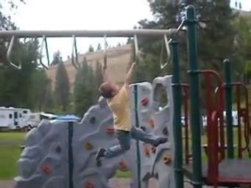
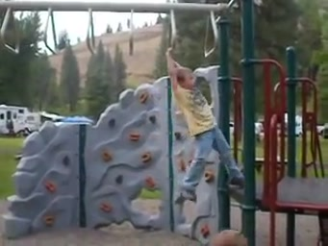
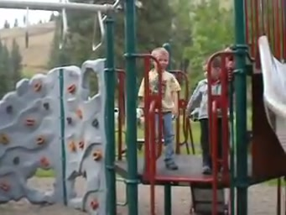
Video Paragraph Captioning
A boy goes across the monkey bars.
At the end he begins to struggle bit, but finally finished.
When he is done another little boy comes and stands by him.
Relevant
Coherent
Concise
ACL 2020
[Krishna et al., ICCV 2017]
Notes:
This is exactly the task of video paragraph captioning. In our setup, we give a list of consective video segments/clips from a single video, and we require the machines to automatically generate [CLICK] a natural language sentence caption for each of the clips,
[CLICK] and meanwhile, the generated caption sentences should form a coherent and concise paragraph when putting together.

Slide 4
Previous work
Decode each segment individually.
Each clip caption is decoded individually without knowing the context, i.e., previous video segments and the captions that have already been generated.
Encoder
Encoder
Encoder
LSTM
LSTM
…
LSTM
LSTM
LSTM
…
LSTM
LSTM
LSTM
…
LSTM
A
man
bars
The
boy
bars
A
boy
camera
A man is seen standing on a playground and begins swinging down a set of monkey bars.
The boy jumps up and down on the monkey bars.
A boy walks up to the camera.
ACL 2020
[Zhou et al., CVPR 2019]
Notes:
One line of work treat video paragraph captioning similarly as single video captioning task, where each caption is decoded individually
without kowing the context, that is, previous video segments and the captions that have already been generated.
Thus the generated captions are usually not coherent and can be redundant.
Below we show such an approach from CVPR 19,
[CLICK]
where each video segment is encoded and decoded individually with an encoder and an LSTM decoder.
As a result, the genenerated single-sentence captions can not form a coherent story, for example, [CLICK] we can see the person mentions are not coherent acorss the generated multiple sentences.

Slide 5
Previous work
Decode each segment individually.
Each clip caption is decoded individually without knowing the context, i.e., previous video segments and the captions that have already been generated.
Encoder
Encoder
Encoder
LSTM
LSTM
…
LSTM
LSTM
LSTM
…
LSTM
LSTM
LSTM
…
LSTM
A
man
bars
The
boy
bars
A
boy
camera
A man is seen standing on a playground and begins swinging down a set of monkey bars.
The boy jumps up and down on the monkey bars.
A boy walks up to the camera.
ACL 2020
[Zhou et al., CVPR 2019]
Notes:
we can see the person mentions are not coherent acorss the generated multiple sentences.

Slide 6
Previous work
Use LSTM word-level hidden state to pass history information.
Pass LSTM decoder’s last (word) hidden state from the previous sentence as the initial hidden state for the next sentence decoding.
The context history information quickly decays due to vanishing gradient.
Encoder
Encoder
Encoder
LSTM
LSTM
…
LSTM
LSTM
LSTM
…
LSTM
LSTM
LSTM
…
LSTM
A
man
bars
The
boy
bars
A
boy
camera
A young child is seen climbing across the monkey bars on a set of monkey bars.
A girl is crossing the monkey bars.
A young boy is seen standing before a set of monkey bars.
ACL 2020
[Xiong et al., ECCV 2018; Gella et al., EMNLP 2018; Pascanu et al., ICML 2013]
Notes:
Another line of work use LSTM word-level hidden state to pass history information.
Specifically,
[CLICK]
they pass LSTM decoder’s last (word) hidden state from the previous sentence as the initial hidden state for the next sentence decoding,
thus enabling information flow from previous sentences to subsequent sentences.
They show slightly better results compared to their single sentence counterparts,
we can see from the examples below, that they are talking about the same event across multiple caption sentences.
However, they are still undesirable as the sentence-level recurrence is achieved at word-level, and the context history information quickly decays due to vanishing gradients.
[CLICK]
As a result, we see that this approach still has the same incoherent person mention issues that we discussed in our last example.

Slide 7
Previous work
Use LSTM word-level hidden state to pass history information.
Pass LSTM decoder’s last (word) hidden state from the previous sentence as the initial hidden state for the next sentence decoding.
The context history information quickly decays due to vanishing gradient.
Encoder
Encoder
Encoder
LSTM
LSTM
…
LSTM
LSTM
LSTM
…
LSTM
LSTM
LSTM
…
LSTM
A
man
bars
The
boy
bars
A
boy
camera
A young child is seen climbing across the monkey bars on a set of monkey bars.
A girl is crossing the monkey bars.
A young boy is seen standing before a set of monkey bars.
ACL 2020
[Xiong et al., ECCV 2018; Gella et al., EMNLP 2018; Pascanu et al., ICML 2013]
Notes:
Another line of work use LSTM word-level hidden state to pass history information.
Specifically,
[CLICK]
they pass LSTM decoder’s last (word) hidden state from the previous sentence as the initial hidden state for the next sentence decoding,
thus enabling information flow from previous sentences to subsequent sentences.
They show slightly better results compared to their single sentence counterparts,
we can see from the examples below, that they are talking about the same event across multiple caption sentences.
However, they are still undesirable as the sentence-level recurrence is achieved at word-level, and the context history information quickly decays due to vanishing gradients.
[CLICK]
As a result, we see that this approach still has the same incoherent person mention issues that we discussed in our last example.

Slide 8
Our approach
Separate Encoder-Decoder Architecture
Shared Encoder-Decoder Architecture
ACL 2020
Notes:
To address these issues, we now introduce our approach.
Starting from a standard vanilla transformer captioning architecture, where the encoder and decoder are separate.
We now make our first change to this base architecture, by sharing its encoder and decoder,
Specifically,
[CLICK]
we concatenate the video segment representation with the caption text as inputs to the transformer layers.
These layers are used for both feature encoding and caption generation. At decoding time, we only decode the positions where the input token is from the text side.
This unified encoder-decoder architecture has the benefit of reducing the #paramaters and thus avoid overfitting.
Meanwhile, it also simplied the original design, making it more flexible for extension.

Slide 9
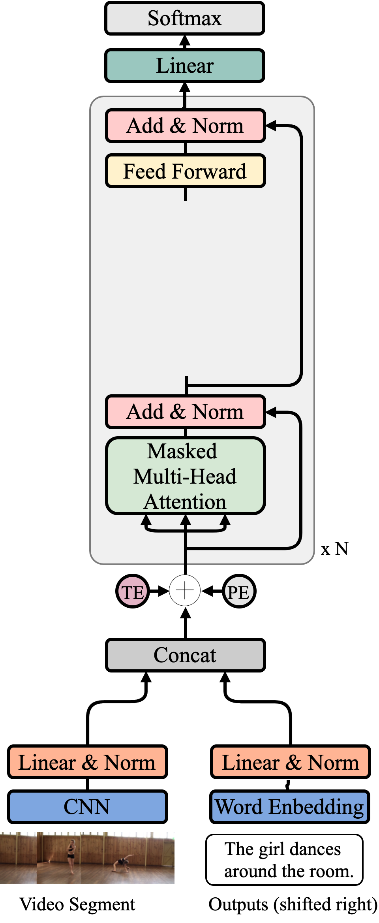
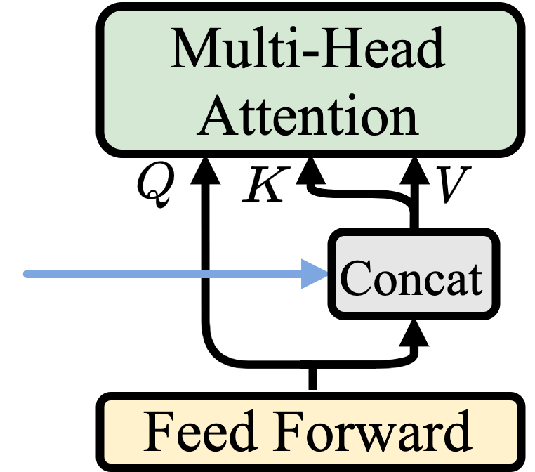
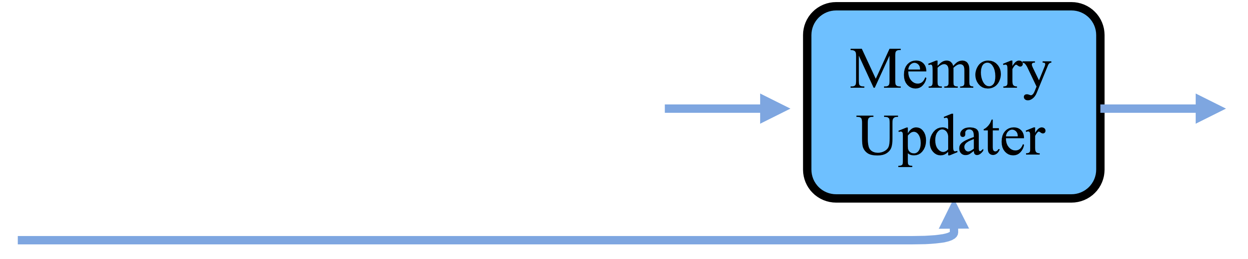
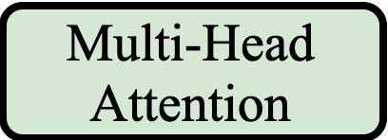
Our approach – Memory Augmented Recurrent Transformer (MART)
Memory Augmentation
: layer l memory states from previous video segments and caption history
: intermediate hidden states
Memory Updater
Takes current segment hidden states and previous memory states to update and obtain current memort states.
at step/sentence t
ACL 2020
Notes:
From the shared encoder-decoder architecture, we add a recurrent module.
[CLICK]
where we use a memory states matrix to pass information across sentences.
We use multi-head attention to combine information from both the current video segment and the history from last memory states to generate current caption sentence.
The memory states are updated using a memory updater [CLICK], which takes [CLICK],

Slide 10
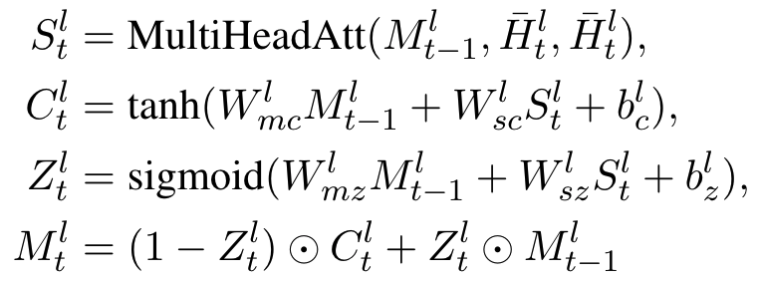
Our approach – Memory Augmented Recurrent Transformer (MART)
Memory Updater
Takes current segment hidden states and previous memory states to update and obtain current memort states
Internal cell states
Update gate
ACL 2020
at step/sentence t
Notes:
... which takes the current segment hidden states and previous memory states to update current memory states.
In the memory module, we compute internal cell states C. And then we use an update gate Z to control how much information to retain from the previous memory states,
and thus reducing redundancy and maintaining coherence in the generated paragraphs.
The design of our memory updater is conceptually similar to recurrent units such as LSTM and GRU,
it differs in that multihead attention is used to encode the memory states and thus multiple memory slots are supported
instead of a single one in LSTM and GRU.

Slide 11
Data and Evaluation Metrics
Datasets:
ActivityNet Captions
YouCookII
Features:
Appearance: 2048D RGB ImageNet image recognition feature from ResNet-200
Motion: 1024D ActivityNet action recognition feature from BN-Inception.
Extracted at 2FPS, and are then normalized and concatenated.
Metrics:
Standard metrics: BLEU@4 (B@4), METEOR (M), CIDEr-D (C)
Repetition: R@4, degree of N-gram (N=4) repetition in a paragraph
ACL 2020
Notes:
We conduct experiments on two widely used datasets ActivityNet Captions and YouCookII.
For video representation, we consider both appearance and motion features.
For appearance, we use 2K features from an image recognition model
And for motion, we use 1K features from an action recognition model
Both features are extracted at 2FPS, and are then normalized and concatenated.
We use standard metrics such as bleu, meteor and cider to evaluate captioning performance.
As these metrics do not consider the redundancy across multiple sentences in a single paragraph, we also use repretion score, R@4,
which measures the degree of N-gram repetition in a paragraph.

Slide 12
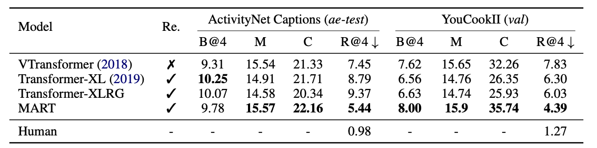
Results
ACL 2020
Notes:
[CLICK]
Our experiments show that our proposed MART model has stronger or comparable performance for standard language metrics for both ActivityNet Captions and YouCookII datasets.
[CLICK]
For R@4, MART produces significantly better results compared to the three transformer baselines, showing its effectiveness in reducing redundancy in the generated paragraphs.

Slide 13
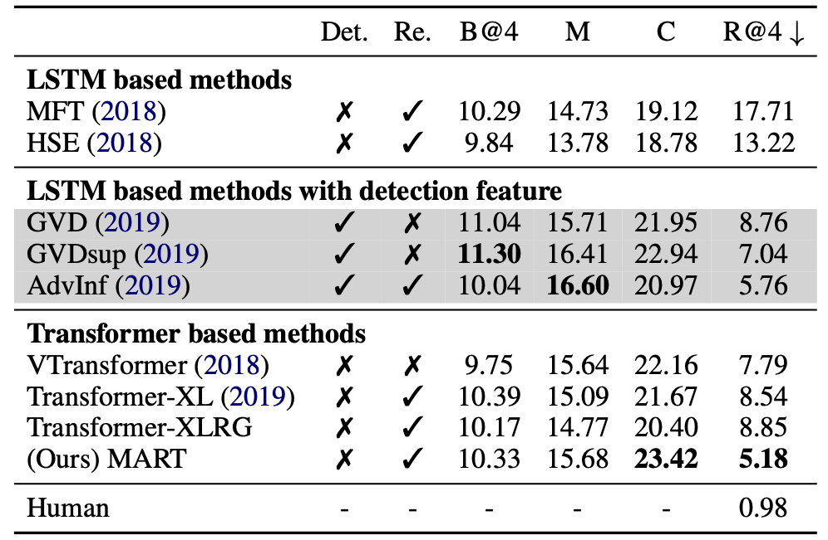
Results
Comparison with state-of-the-art on ActivityNet ae-val split.
ACL 2020
Notes:
Here we show the comparison between MART with state-of-the-art models on ActivityNet Captions.
Models with stronger detection features are shown in gray background to indicate they are not in fair comparison with the others.
[CLICK]
From this table, we notices that MART achieves the best CIDEr and Repetition@4 scores.
[CLICK]
Regarding repetition score, we notice MART is even stronger than the Adversarial Inference model,
where multiple specifically designed discriminators are adversarially trained to generate more coherent and less redundant paragraphs.

Slide 14
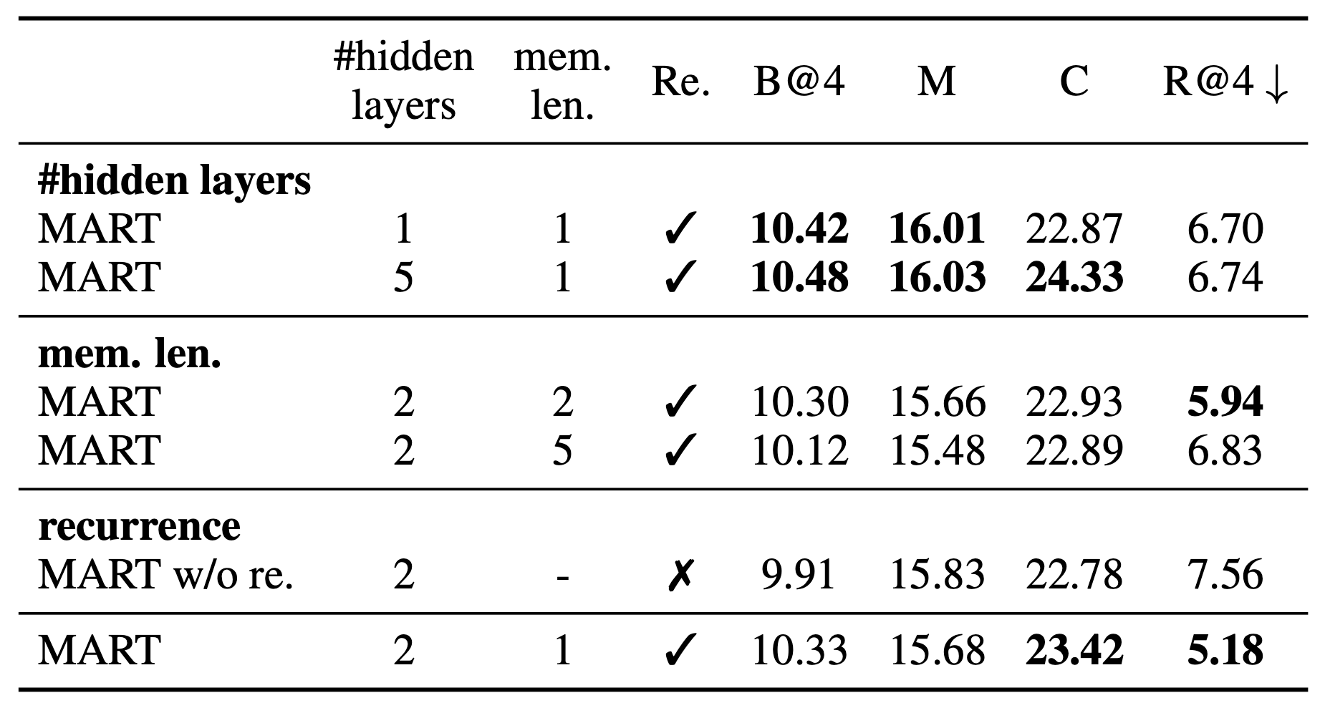
Results
Ablation study on ActivityNet ae-val split.
ACL 2020
Notes:
In this page we show model ablation study.
[CLICK]
The most important oberservation here is that the MART variant without recurrence performs worse on most metrics, especially for the repetition score, which indicates recurrent mechanism is useful in generating more coherent and concise paragraph caption.

Slide 15
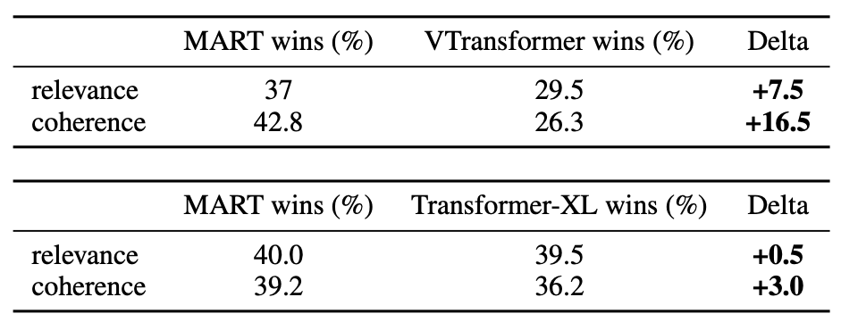
Human Evaluation
Relevance: how related is a generated paragraph caption to the content of the given video.
Coherence: whether a generated paragraph caption reads fluently and is linguistically coherent over its multiple sentences.
We sampled 200 generated paragraphs for the compared methods. We compare two methods at a time. The models are anonymized, and the predictions are shuffled.
ACL 2020
Notes:
As automatic evaluation is not perfect, we also conduct human evaluation on Amazon Mechianical Turk (AMT) with 200 randomly sampled videos from ActivityNet Captions. We perform human evaluation in terms of two aspects, relevance, how related is a generated paragraph caption to the content of the given video. And coherence, whether a generated paragraph caption reads fluently and is linguistically coherent over its multiple sentences. Each video was judged by 3 workers. We design pairwise experiments where we compare two methods at a time, the workers are instructed to select which method is better, and there is also a not-distinguishable option. The models are anonymized and the predictions are shuffled.
[CLICK] Compared to the non-recurrent transformer model, (Vanilla Transformer), we see that MART is substantially better for both relevance and coherence.
[CLICK]Compared to the strong recurrent transformer-XL captioning model, we see that MART has similar performance in terms of relevance, but better performance in terms of coherence.
Both obserbvations are consistent with our automatic evaluation.

Slide 16
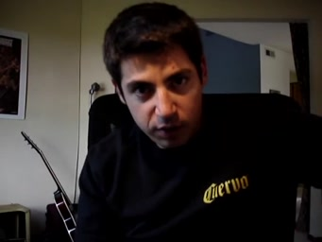
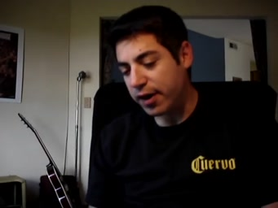
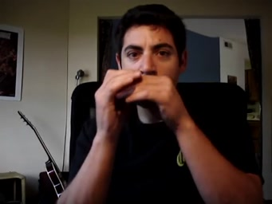
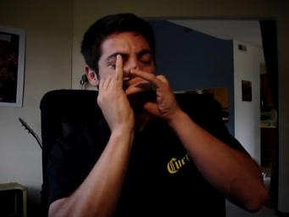
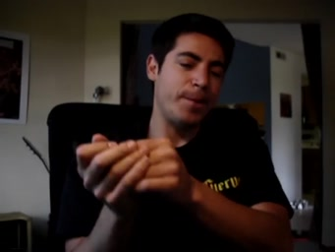
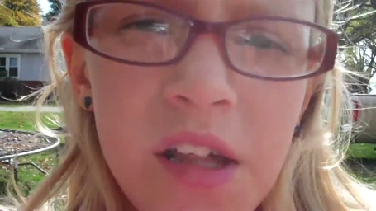
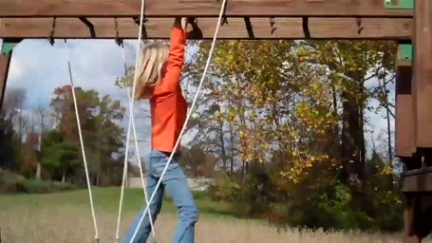
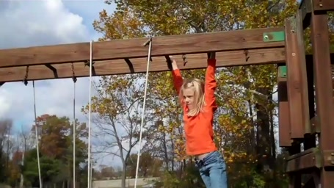
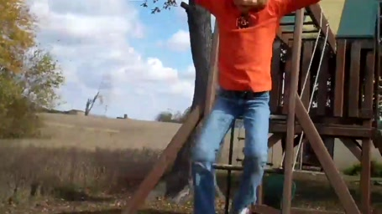
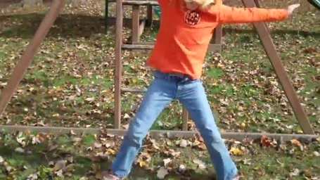
Qualitative Examples
Vanilla Transformer
Vanilla Transformer
He is sitting down in a chair. He continues playing the harmonica and ends by looking off into the distance. He continues playing the harmonica and looking off into the distance. He stops playing and looks at the camera.
A girl is seen climbing across a set of monkey bars and leads into her climbing across a set of. He jumps off the monkey bars and lands on a bridge.
Transformer-XL
Transformer-XL
A man is seen speaking to the camera while holding a harmonica. He continues playing the harmonica while looking at the camera. He continues playing the instrument and looking off into the distance. He continues playing and stops playing.
A young child is seen climbing across a set of monkey bars and climbing across a set of monkey bars. The boy jumps down and jumps down and jumps down.
MART (ours)
MART (ours)
A man is sitting down talking to the camera while holding a camera. He takes a harmonica and begins playing his harmonica. He continues playing the harmonica as he continues playing. He stops and looks at the camera.
A girl is seen speaking to the camera and leads into her climbing across a set of monkey bars. She jumps off the bar and walks back to the camera.
Ground-Truth
Ground-Truth
A young man wearing a Cuervo black shirt stares and speaks to the camera as he sits on his chair. He puts a harmonica to his mouth and begins playing. He plays on for about a minute and is very into his song. He then puts the harmonica down and looks into the camera as the video comes to an end.
A little girl climbs the monkey bars of a play ground. Then, the little girl jumps to the ground and extend her arms.
MART is typically more coherent, less redundant
ACL 2020
Notes:
Here we show the generated paragraph captions.
Compared to the two baselines, MART produces more coherent and less redundant paragraphs.
In particular, we noticed that the vanilla transformer often uses incoherent pronouns/person mentions [CLICK], while MART and Transformer-XL

Slide 17
Qualitative Examples
Vanilla Transformer
Vanilla Transformer
He is sitting down in a chair. He continues playing the harmonica and ends by looking off into the distance. He continues playing the harmonica and looking off into the distance. He stops playing and looks at the camera.
A girl is seen climbing across a set of monkey bars and leads into her climbing across a set of. He jumps off the monkey bars and lands on a bridge.
Transformer-XL
Transformer-XL
A man is seen speaking to the camera while holding a harmonica. He continues playing the harmonica while looking at the camera. He continues playing the instrument and looking off into the distance. He continues playing and stops playing.
A young child is seen climbing across a set of monkey bars and climbing across a set of monkey bars. The boy jumps down and jumps down and jumps down.
MART (ours)
MART (ours)
A man is sitting down talking to the camera while holding a camera. He takes a harmonica and begins playing his harmonica. He continues playing the harmonica as he continues playing. He stops and looks at the camera.
A girl is seen speaking to the camera and leads into her climbing across a set of monkey bars. She jumps off the bar and walks back to the camera.
Ground-Truth
Ground-Truth
A young man wearing a Cuervo black shirt stares and speaks to the camera as he sits on his chair. He puts a harmonica to his mouth and begins playing. He plays on for about a minute and is very into his song. He then puts the harmonica down and looks into the camera as the video comes to an end.
A little girl climbs the monkey bars of a play ground. Then, the little girl jumps to the ground and extend her arms.
MART is typically more coherent, less redundant
ACL 2020
Notes:
are able to use suitable pronouns and person mentions across the sentences and thus improve the coherence of the paragraph.
Compare with both Vanilla Transformer and Transformer-XL,
[CLICK]

Slide 18
Qualitative Examples
Vanilla Transformer
Vanilla Transformer
He is sitting down in a chair. He continues playing the harmonica and ends by looking off into the distance. He continues playing the harmonica and looking off into the distance. He stops playing and looks at the camera.
A girl is seen climbing across a set of monkey bars and leads into her climbing across a set of. He jumps off the monkey bars and lands on a bridge.
Transformer-XL
Transformer-XL
A man is seen speaking to the camera while holding a harmonica. He continues playing the harmonica while looking at the camera. He continues playing the instrument and looking off into the distance. He continues playing and stops playing.
A young child is seen climbing across a set of monkey bars and climbing across a set of monkey bars. The boy jumps down and jumps down and jumps down.
MART (ours)
MART (ours)
A man is sitting down talking to the camera while holding a camera. He takes a harmonica and begins playing his harmonica. He continues playing the harmonica as he continues playing. He stops and looks at the camera.
A girl is seen speaking to the camera and leads into her climbing across a set of monkey bars. She jumps off the bar and walks back to the camera.
Ground-Truth
Ground-Truth
A young man wearing a Cuervo black shirt stares and speaks to the camera as he sits on his chair. He puts a harmonica to his mouth and begins playing. He plays on for about a minute and is very into his song. He then puts the harmonica down and looks into the camera as the video comes to an end.
A little girl climbs the monkey bars of a play ground. Then, the little girl jumps to the ground and extend her arms.
MART is typically more coherent, less redundant
ACL 2020
Notes:
we found that the paragraphs generated by MART have much less repetitions.
We attribute MART’s success to its recurrence design - the previous memory states are highly summarized, in which redundant information is removed.

Slide 19

Thanks!
Linear &
Softmax
https://github.com/jayleicn/recurrent-transformer
Linear
Linear &
Softmax
ACL 2020
Notes:
Our code is publicly available at the following link. Thanks for your attention!

